Slide 1

Workforce Pulse 2025
The agile people leader: Smarter decisions for the future of work
Presenter:
Date:
Core stats HR leaders need
Notes:
Set the tone: This deck summarises Workforce Pulse 2025 for HR leaders. It focuses on three converging forces — Decision Intelligence, AI integration, and demographic shifts — and concrete actions for the next 90 days. Designed for a 12–15 minute run-through.

Slide 2
Agenda
01
Executive summary and key figures
02
Business context: Cautious optimism
03
Three themes:
The science of better people decisions
AI-enabled workforce planning
Adapting to an aging workforce
04
What to do today
Notes:
We’ll start with the executive summary and business outlook (signs of cautious optimism), then cover the three forces shaping 2025, highlight the most important findings (costs, engagement, AI readiness), and close with a pragmatic checklist.

Slide 3
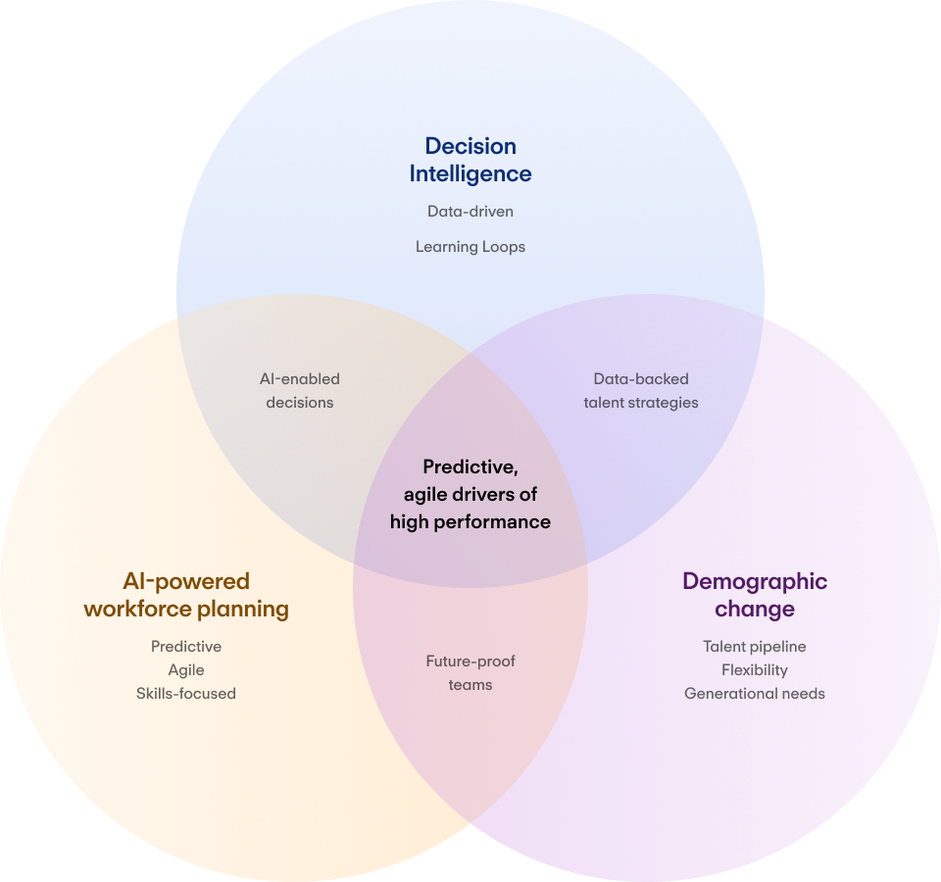
Executive summary
Why this year stands out
Notes:
This year isn’t just ‘more change’ — it’s the pace and impact. Decision intelligence, AI, and demographic change are converging and raising the stakes for people decisions.
Decision intelligence moves HR from reactive to predictive; AI is redefining roles, workflows and skills needs; demographic shifts and an aging workforce are reshaping supply, expectations, and urgency around knowledge transfer.
Scaling businesses can outpace larger organisations when HR aligns all of these forces:
DI × AI = AI-enabled decisions
AI × Demographics = future-proof teams
Demographics × DI = data-backed talent strategies
At the centre: predictive, agile drivers of high performance.

Slide 4

Key findings
at a glance
39%
35%
of HR leaders report engagement deterioration.
Employees who want more support with AI are 35% more likely to be job hunting.
£235,107
2x
7%
average annual cost from preventable people issues (turnover, mis-hires, skills gaps, weak L&D, planning errors).
Employees who feel trusted to work remotely are >2x as likely to be highly motivated.
Only 7% of HR leaders are “advanced decision-makers”
51%
36%
65%
of employees plan to change jobs; retention risk is elevated.
Only 36% get adequate AI training; 44% want more.
65% are prioritising skills-based hiring; 66% say skills matter more than degrees
Notes:
Use these numbers to align the team on core insights of the report:
Big avoidable costs
Elevated retention risk
Engagement concerns
AI training gap
HR decision-making gap
Focus on skills
Reduced redundancy expectations, leading to the next slide explaining cautious optimism in business context

Slide 5
Business context
Cautious optimism
69% report high business success in 2025.
Redundancy expectations down 21 points (60% → 39%).
Fewer expect declines in profitability, recruitment, HR budgets, and compensation.
INFOGRAPHIC
Year-on-year expectations
Bars/tiles for 2024 vs 2025: profitability, recruitment, budgets, compensation.
Notes:
Confidence is returning; layoffs easing.
69% report high overall business success in 2025.
Redundancy expectations fell 21 points (60%→39%)
Signalling a shift from defensive measures to more strategic planning across profitability, recruitment, budgets, and compensation.
Bar chart: Fewer decreases expected, more balance and investment.

Slide 6
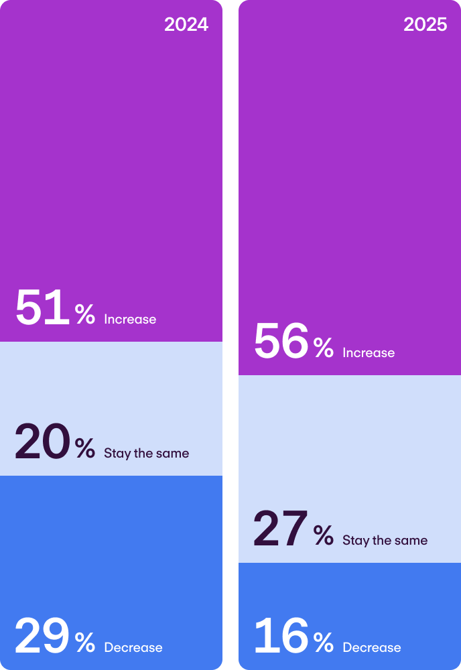
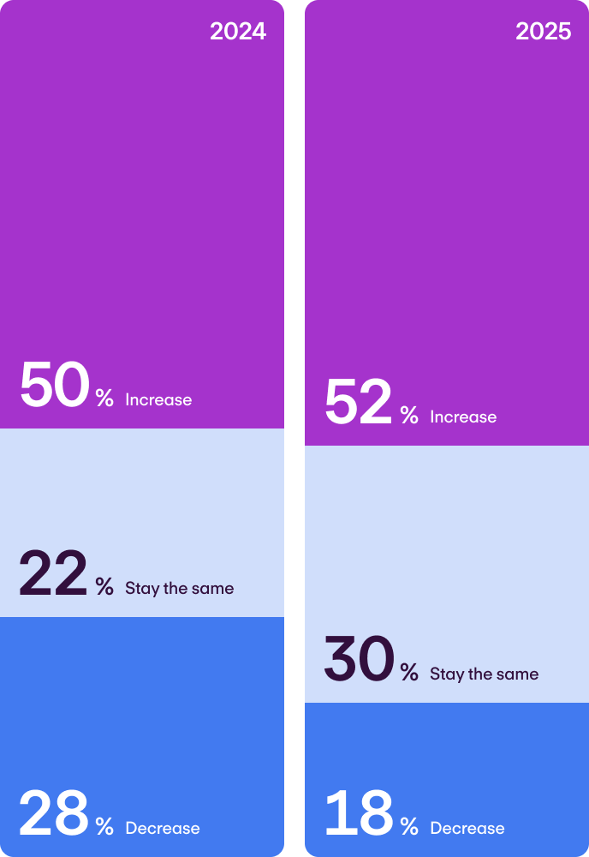
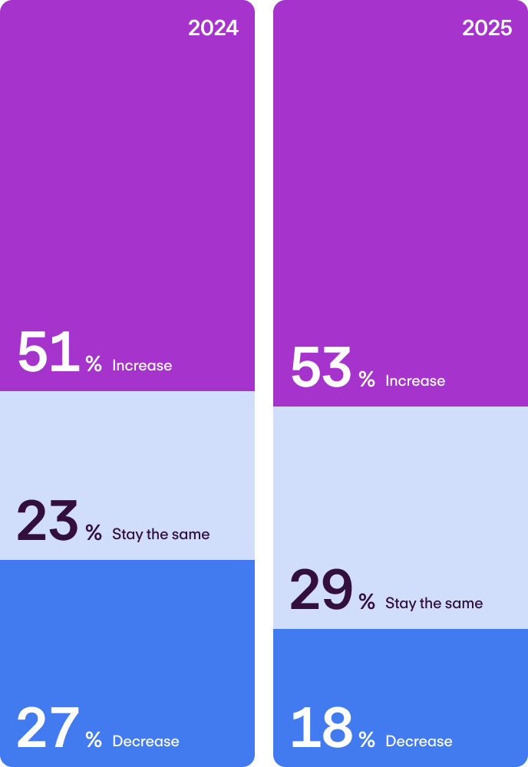
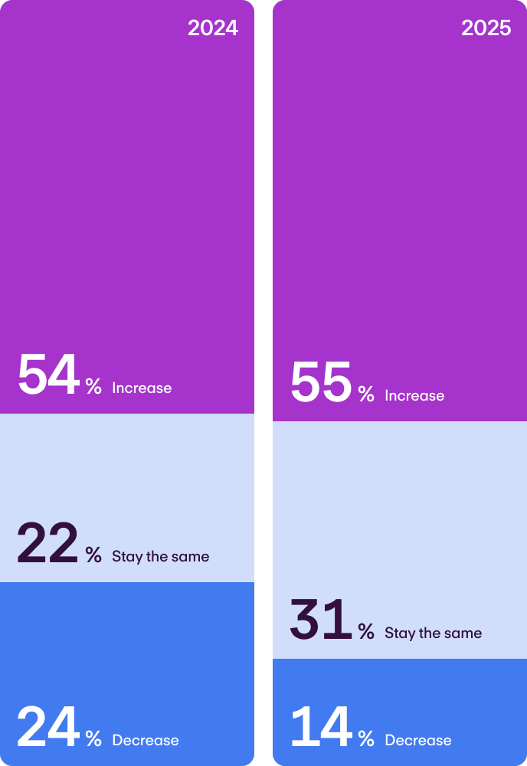
Business context
Cautious optimism
69% report high business success in 2025.
Redundancy expectations down 21 points (60% → 39%).
Fewer expect declines in profitability, recruitment, HR budgets, and compensation.
Business profitability
Overall recruitment
HR budgets
Average pay / compensation
- Business profitability
Business profitability
Business profitability
Business profitability
Overall recruitment
- Overall recruitment
Overall recruitment
Overall recruitment
HR budgets
HR budgets
- HR budgets
HR budgets
Average pay / compensation
Average pay / compensation
Average pay / compensation
- Average pay / compensation
Notes:
Confidence is returning; layoffs easing.
69% report high overall business success in 2025.
Redundancy expectations fell 21 points (60%→39%)
Signalling a shift from defensive measures to more strategic planning across profitability, recruitment, budgets, and compensation.
Bar chart: Fewer decreases expected, more balance and investment.

Slide 7
Theme 1: The science of better people decisions
The avoidable bill is big: >£235k per org.
The answer isn’t ‘more data,’ but disciplined decisions to reduce rework and mistakes. Yet only 7% of HR leaders are ‘advanced decision-makers’ (strategic data use + documented decisions).
46% struggle to leverage people data
19% use it strategically
13% formally review predictions
→ Simple frameworks, documentation, and reviews build a repeatable playbook for pairing judgement with evidence.
Notes:
The average cost of preventable people problems was >£235k in the past year per organisation.
Only 7% of HR leaders are ‘advanced decision-makers’ — they use people data strategically and document decisions, creating learning loops. 19% say they use data strategically; just 13% review prediction accuracy. 46% struggle to leverage people data due to analysis/usage challenges.
To address this, focus on process, documentation, and review cycles to pair judgement with evidence.

Slide 8

Theme 1:
The science of better people decisions
13%
19%
The answer isn’t ‘more data,’ but disciplined decisions to reduce rework and mistakes. Yet only 7% of HR leaders are ‘advanced decision-makers’ (strategic data use + documented decisions).
formally review predictions
use data strategically
The avoidable bill is big:
46%
Simple frameworks, documentation, and reviews build a repeatable playbook for pairing judgement with evidence.
>£235k
struggle to leverage people data
per org in the last year
Notes:
The average cost of preventable people problems was >£235k in the past year per organisation.
Only 7% of HR leaders are ‘advanced decision-makers’ — they use people data strategically and document decisions, creating learning loops. 19% say they use data strategically; just 13% review prediction accuracy. 46% struggle to leverage people data due to analysis/usage challenges.
To address this, focus on process, documentation, and review cycles to pair judgement with evidence.

Slide 9
Unlocking performance: Where advanced decision-makers stand out
INFOGRAPHIC
Very high business performance: 48% vs 18%
Very high engagement: 45% vs 18%
Turnover prediction confidence: 76% vs 51%
Formal prediction reviews: 46% vs 10%
HR valued and trusted: 90% vs 69%
HR trusted by leadership: 88% vs 67%
Notes:
Teams in the ‘sweet spot’ are more likely to report: very high business performance; very high engagement; higher confidence predicting turnover; formal review cycles.
HR is more trusted and valued by the organisation and leadership, showing the cultural payoff of disciplined decision-making.

Slide 10
Unlocking performance: Where advanced decision-makers stand out
76%
Turnover
prediction confidence:
51%
46%
Advanced decision makers
Formal
prediction
reviews:
Everyone else
10%
48%
90%
Very high
business performance:
HR valued
and trusted:
18%
69%
45%
88%
Very high engagement:
HR trusted
by leadership:
18%
67%
Notes:
Teams in the ‘sweet spot’ are more likely to report: very high business performance; very high engagement; higher confidence predicting turnover; formal review cycles.
HR is more trusted and valued by the organisation and leadership, showing the cultural payoff of disciplined decision-making.

Slide 11
Theme 2: AI-enabled workforce planning
Momentum:
  43% of HR leaders use AI for planning
  64% are assessing the impact of AI on skills needs
  47% are increasing spend
Cost of missteps: £49,499 on average last year due to inadequate workforce planning
Use cases:
Turnover prediction
Succession planning
Upskilling/reskilling recommendations
Flexible, project-based team assembly
Notes:
AI is now core to workforce planning: 43% are using AI strategically for this purpose and 64% are assessing AI’s impact on future skills need. 47% plan a higher spend in the next year.
Getting planning wrong cost ~£49.5k on average last year. Advanced decision-makers are also more likely to use predictive analytics regularly.
AI supports turnover prediction (signals from surveys/absence), succession (internal readiness), upskilling (personalised learning paths), and flexible staffing (project-based assembly across locations).

Slide 12
Use cases:
Turnover
prediction
Succession
planning
Upskilling/reskilling recommendations
Theme 2:
AI-enabled workforce planning
Flexible, project-based team assembly
46%
64%
Workforce planning is about building the right teams, with the right skills, exactly when and where you need them — but we’re at a critical inflection point. AI is fundamentally changing how work gets done, who does it, and how people teams prepare for future needs.
of HR leaders use AI for planning
are assessing the impact of AI on skills needs
Cost of missteps:
AI use cases:
Turnover prediction
Succession planning
Upskilling/reskilling recommendations
Flexible, project-based team assembly
47%
£49,499
are increasing spend on AI
on average last year due to inadequate workforce planning
Notes:
AI is now core to workforce planning: 43% are using AI strategically for this purpose and 64% are assessing AI’s impact on future skills need. 47% plan a higher spend in the next year.
Getting planning wrong cost ~£49.5k on average last year. Advanced decision-makers are also more likely to use predictive analytics regularly.
AI supports turnover prediction (signals from surveys/absence), succession (internal readiness), upskilling (personalised learning paths), and flexible staffing (project-based assembly across locations).

Slide 13
Where AI is at work
INFOGRAPHIC
Notes:
Adoption snapshot of AI in HR:
Admin automation 46% (frees HR for higher-value work);
Strategic planning 43% (turn hindsight into foresight);
Personalised experiences 41% (drives retention);
Decision-support 40% (cuts costly mistakes);
Recruitment 36% (faster hiring);
Leadership augmentation 33% (multiplies managerial impact).
High performers select more AI use cases on average (3 vs 2) and are more likely to increase AI/automation spend (52% vs 35%). High-performing team leaders are treating AI as a toolkit rather than a one-off solution.

Slide 14
Where AI is at work
HR leaders
using AI today
AI use-case
Why it matters
46%
Administrative automation
Frees HR for higher-value work
43%
Strategic workforce planning
Turns hindsight into foresight
41%
Personalised employee experiences
Drives retention and engagement
40%
Decision-support / predictive tools
Cuts costly people mistakes
36%
Recruitment sourcing & screening
Speeds up hiring in tight markets
33%
Leadership augmentation
Multiplies managerial impact
Notes:
Adoption snapshot of AI in HR:
Admin automation 46% (frees HR for higher-value work);
Strategic planning 43% (turn hindsight into foresight);
Personalised experiences 41% (drives retention);
Decision-support 40% (cuts costly mistakes);
Recruitment 36% (faster hiring);
Leadership augmentation 33% (multiplies managerial impact).
High performers select more AI use cases on average (3 vs 2) and are more likely to increase AI/automation spend (52% vs 35%). High-performing team leaders are treating AI as a toolkit rather than a one-off solution.

Slide 15
Where AI is at work
HR leaders using AI today
AI use-case
Why it matters
46%
Administrative automation
Frees HR for higher-value work
43%
Strategic workforce planning
Turns hindsight into foresight
41%
Personalised employee experiences
Drives retention and engagement
40%
Decision-support / predictive tools
Cuts costly people mistakes
36%
Recruitment sourcing & screening
Speeds up hiring in tight markets
33%
Leadership augmentation
Multiplies managerial impact
Notes:
Adoption snapshot of AI in HR:
Admin automation 46% (frees HR for higher-value work);
Strategic planning 43% (turn hindsight into foresight);
Personalised experiences 41% (drives retention);
Decision-support 40% (cuts costly mistakes);
Recruitment 36% (faster hiring);
Leadership augmentation 33% (multiplies managerial impact).
High performers select more AI use cases on average (3 vs 2) and are more likely to increase AI/automation spend (52% vs 35%). High-performing team leaders are treating AI as a toolkit rather than a one-off solution.

Slide 16
The AI-enablement gap
Use is rising: 43% already use AI.
Confidence: 66% of employees believe their skills will remain relevant; 49% are actively upskilling in AI.
Gap: only 36% get adequate training from their employer; 44% want more.
  Those wanting support are 35% more likely to be job-hunting.
Notes:
Usage is up: 43% of employees use AI (up from 24% in 2024).
Confidence is reasonably high (66% believe their skills will remain relevant with 49% actively upskilling in AI).
But a support gap persists: only 36% get adequate training; 39% know very little; 44% want more help. Those wanting more support are 35% more likely to be job-hunting — an attrition risk HR leaders can’t afford to ignore.

Slide 17
The AI-enablement gap
Use is rising:
Confidence:
65%
66%
43%
already use AI
of employees believe their skills will remain relevant
are actively upskilling in AI
Gap:
36%
44%
get adequate training from their employer
want more: those wanting support are 35% more likely to be job-hunting
Notes:
Usage is up: 43% of employees use AI (up from 24% in 2024).
Confidence is reasonably high (66% believe their skills will remain relevant with 49% actively upskilling in AI).
But a support gap persists: only 36% get adequate training; 39% know very little; 44% want more help. Those wanting more support are 35% more likely to be job-hunting — an attrition risk HR leaders can’t afford to ignore.

Slide 18
Training changes outcomes
INFOGRAPHIC
Adequate vs inadequate training
Productivity 70% vs 56%;
Motivation 62% vs 37%.
Career development 60% vs 31%;
Trust in leadership 40% vs 22%.
→ Invest in enablement to protect performance and retention.
Notes:
Employees who get adequate training in the use of AI report higher productivity, higher motivation, higher satisfaction with their career development, and greater trust in leadership.
Encourage closing the training gap to protect engagement and retention.

Slide 19
Training
changes outcomes
Employees receiving adequate AI training
Employees receiving inadequate AI training
Invest in enablement to protect performance and retention.
High productivity
High motivation
High satisfaction with career development
High trust in
senior leadership
70%
56%
62%
37%
60%
31%
40%
22%
Notes:
Employees who get adequate training in the use of AI report higher productivity, higher motivation, higher satisfaction with their career development, and greater trust in leadership.
Encourage closing the training gap to protect engagement and retention.

Slide 20
Emerging trend: Skills-based organisations
Qualifications are out — skills are in. The data shows a decisive shift:
HR leaders:
65% are focusing more on skills-based hiring
66% say skills and aptitude are more important than degrees
Employees:
52% say degrees are losing importance
64% want more focus on transferable skills
Drivers:
Skills shortages: 39% of HR leaders cite this as a top barrier to success, 52% expect overall recruitment needs to rise
AI is accelerating the trend: 43% of HR leaders are using AI for strategic workforce planning, 43% are using AI to support recruitment
Notes:
HR leaders and employees alike are signalling a desire for more skills-based approaches to hiring and job architecture.
With skills shortages remaining top-of-mind for businesses, HR leaders have an opportunity to instil skills-based practices in their hiring, onboarding, and team building.

Slide 21
Emerging trend:
Skills-based organisations
Qualifications are out — skills are in. The data shows a decisive shift.
HR leaders:
Employees:
Drivers
65%
52%
Skills shortages:
39% of HR leaders cite this as a top barrier to success, 52% expect overall recruitment needs to rise.
are focusing more on skills-based hiring
say degrees are losing importance
66%
64%
AI is accelerating the trend:
43% of HR leaders are using AI for strategic workforce planning, 43% are using AI to support recruitment.
say skills and aptitude are more important than degrees
want more focus on transferable skills
Notes:
HR leaders and employees alike are signalling a desire for more skills-based approaches to hiring and job architecture.
With skills shortages remaining top-of-mind for businesses, HR leaders have an opportunity to instil skills-based practices in their hiring, onboarding, and team building.

Slide 22
Theme 3: Adapting to an aging workforce
With a shrinking working-age population comes a talent squeeze and knowledge-loss risk.
Today:
59% of HR leaders say hiring is harder than 5 years ago
50% struggle to fill vacancies
36% identify attracting under-30s as top challenge (47% struggle to do so)
62% are adjusting their strategy to better attract entry-level talent
→ Scaling businesses have an opportunity to modernise early-career pathways, positioning themselves as places where young talent can develop important skills.
Notes:
The new demographic reality: the working-age population is shrinking, and knowledge is at risk as older workers retire.
59% of HR leaders say hiring is harder than five years ago; 50% are struggling to fill roles; 36% cite attracting younger talent as the top people challenge; 47% specifically struggle to attract under-30s.
In response, 65% are prioritising entry-level hiring/development and 62% are already adjusting their strategies to better attract this group.
By developing skills-based career paths and offering personalised development opportunities, scaling businesses can compete effectively with larger organisations for Gen Z talent while simultaneously building a loyal workforce aligned with organisational priorities and skill needs.

Slide 23
Theme 3:
Adapting to an aging workforce
With a shrinking working-age population comes a talent squeeze and knowledge-loss risk.
59%
50%
36%
62%
of HR leaders say hiring is harder than
5 years ago
struggle to fill
vacancies
identify attracting under-30s as top challenge (47% struggle to do so)
are adjusting their strategy to better attract entry-level talent
Scaling businesses have an opportunity to modernise early-career pathways, positioning themselves as places where young talent can develop important skills.
Notes:
The new demographic reality: the working-age population is shrinking, and knowledge is at risk as older workers retire.
59% of HR leaders say hiring is harder than five years ago; 50% are struggling to fill roles; 36% cite attracting younger talent as the top people challenge; 47% specifically struggle to attract under-30s.
In response, 65% are prioritising entry-level hiring/development and 62% are already adjusting their strategies to better attract this group.
By developing skills-based career paths and offering personalised development opportunities, scaling businesses can compete effectively with larger organisations for Gen Z talent while simultaneously building a loyal workforce aligned with organisational priorities and skill needs.

Slide 24
The impact is already hitting the bottom line. In the past year alone:
INFOGRAPHIC
Knowledge loss last year: 39% £10k–£50k; 15% £50k–£100k
Difficulty attracting talent: 37% £10k–£50k; 15% £50k–£100k
Actions:
Pair retiring workers with early-career talent
Document key processes
Create opportunities for cross-generational mentoring
Notes:
Costs related to these demographic shifts are already material:
Knowledge loss — 39% faced £10k–£50k; 15% £50k–£100k.
Difficulty attracting talent — 37% faced £10k–£50k; 15% £50k–£100k.
HR teams should take the following actions now to avoid costs associated with knowledge-loss: pair retiring experts with early-career talent; document processes; foster cross-generational mentoring.

Slide 25
The impact is already hitting the bottom line. In the past year alone:
Faced costs
of £10k–£50k
Faced costs of £50k–£100k
Knowledge loss
Difficulty attracting talent
Actions
Pair retiring workers with early-career talent
Document key processes
Create opportunities for cross-generational mentoring
39%
15%
37%
15%
Notes:
Costs related to these demographic shifts are already material:
Knowledge loss — 39% faced £10k–£50k; 15% £50k–£100k.
Difficulty attracting talent — 37% faced £10k–£50k; 15% £50k–£100k.
HR teams should take the following actions now to avoid costs associated with knowledge-loss: pair retiring experts with early-career talent; document processes; foster cross-generational mentoring.

Slide 26
Hybrid expectations: Meeting the needs of Gen Z
For many, hybrid work practices are now an expectation rather than a perk.
[Pie chart:]
Hybrid work at a glance
Hybrid: 57% of employees
Fully office-based: 37% of employees
Almost or entirely remote: 6%
But many employees feel unheard when it comes to hybrid policy:
Only 53% say their employer has kept its promises about hybrid working
Only 45% say employees were consulted before decisions were made about hybrid working policies
Notes:
In a context where hybrid is now the norm, smart hybrid working structures — ones where employees are trusted to work well remotely as well as in-office — aren’t just nice-to-haves. They’re strong drivers for both attraction and retention. Yet only 53% say their employer has kept its promises about hybrid working, and less than half (45%) say employees were consulted before decisions were made about hybrid working policies.

Slide 27

Hybrid expectations:
Meeting the needs of Gen Z
For many, hybrid work practices are now an expectation rather than a perk.
Hybrid work at a glance:
But many employees feel unheard when
it comes to hybrid policy:
37%
6%
53%
Fully
office-based
Almost or entirely remote
say their employer has kept its promises about hybrid working
45%
say employees were consulted before decisions were made about hybrid working policies
57%
Hybrid
Notes:
Hybrid is now the norm, and smart hybrid working structures — ones where employees are trusted to work well remotely as well as in-office — aren’t just nice-to-haves. They’re strong drivers for both attraction and retention.
Yet only 53% say their employer has kept its promises about hybrid working, and less than half (45%) say employees were consulted before decisions were made about hybrid working policies.

Slide 28
What changes when remote workers feel trusted
When remote workers feel trusted, they’re >2x more likely to be highly motivated, and less likely to leave.
INFOGRAPHIC
 | Leadership trusts employees to work well remotely | Leadership does not trust employees to work well remotely
High motivation | 59% | 23%
High productivity | 69% | 42%
Intention to look for a new job (next 12 months) | 41% | 66%
High trust in CEO | 37% | 9%
High trust in HR | 41% | 13%
Notes:
Trust matters.
The data shows a strong correlation between employees’ perceptions of being trusted to work remotely or from home and positive outcomes across motivation, productivity, and engagement.
Employees who feel trusted are more than twice as likely to report high motivation (59% vs. 23%) and more than half as likely to report high productivity (69% vs. 42%). They’re also less likely to be looking for a new job in the next year (41% vs. 66%), and significantly more likely to express high trust in both their CEO and HR.
This underscores the importance of trust as a key ingredient in successful hybrid teams, and a critical lever for hybrid-native leadership in a year where 39% are reporting engagement dips.

Slide 29
What changes when remote workers feel trusted
When remote workers feel trusted, they’re >2x more
likely to be highly motivated, and less likely to leave.
Leadership trusts employees to work well remotely
Leadership does not trust employees to work well remotely
59%
23%
High motivation
High productivity
69%
42%
Intention to look for a new job (next 12 months)
41%
66%
High trust in CEO
37%
9%
High trust in HR
41%
13%
Notes:
Trust matters.
The data shows a strong correlation between employees’ perceptions of being trusted to work remotely or from home and positive outcomes across motivation, productivity, and engagement.
Employees who feel trusted are more than twice as likely to report high motivation (59% vs. 23%) and more than half as likely to report high productivity (69% vs. 42%). They’re also less likely to be looking for a new job in the next year (41% vs. 66%), and significantly more likely to express high trust in both their CEO and HR.
This underscores the importance of trust as a key ingredient in successful hybrid teams, and a critical lever for hybrid-native leadership in a year where 39% are reporting engagement dips.

Slide 30
What to do today
Decision discipline:
  Pick one high-impact decision → Define 3–5 leading indicators → Document assumptions and outcomes → Review monthly
AI enablement & skills-first practices:
  Determine baseline usage and upskilling needs → Roll out training
  Pilot 1–2 planning use cases in HR → Track impact
  Map skills in one department → Update job posts/interviews → Build a capability dashboard from existing data
Demographics:
  Launch knowledge-transfer pairs
  Standardise process docs → Refresh early-career pathways/EVP
Notes:
Decision Intelligence: pick one decision area (retention or hiring); define leading indicators; use a simple decision journal to capture data, assumptions, intuition, predicted outcomes; review monthly.
AI enablement: determine baseline usage and upskilling needs across the organisation; roll out foundational training; prioritise 1–2 planning use cases in HR (eg. turnover prediction, skills gap analysis); measure impact on productivity, motivation, trust.
Skills-first: pilot skills mapping in one function; update job posts/interviews for a skills-first approach; build a capability dashboard from existing data (ie. what skills do you have in your organisation? Where do they sit within teams?
Demographics: set up knowledge-transfer pairs; standardise process documentation to retain institutional knowledge; refresh early-career pathways and Employer Value Proposition for under-30s.

Slide 31



Conclusion:
What to do today
Decision discipline
AI enablement & skills-first practices
Demographic change
Pick one high-impact decision
Determine baseline usage
and upskilling needs
Launch knowledge-transfer pairs
→
Define 3–5 leading indicators
→
Roll out training
→
Standardise process docs
Pilot 1–2 planning use
cases in HR + track impact
→
Refresh early-career pathways/EVP
→
Document assumptions and outcomes
→
Review monthly
Map skills in one department
→
Update job posts/interviews
→
Build a capability dashboard from existing data
Notes:
Decision Intelligence: pick one decision area (retention or hiring); define leading indicators; use a simple decision journal to capture data, assumptions, intuition, predicted outcomes; review monthly.
AI enablement: determine baseline usage and upskilling needs across the organisation; roll out foundational training; prioritise 1–2 planning use cases in HR (eg. turnover prediction, skills gap analysis); measure impact on productivity, motivation, trust.
Skills-first: pilot skills mapping in one function; update job posts/interviews for a skills-first approach; build a capability dashboard from existing data (ie. what skills do you have in your organisation? Where do they sit within teams?
Demographics: set up knowledge-transfer pairs; standardise process documentation to retain institutional knowledge; refresh early-career pathways and Employer Value Proposition for under-30s.

Slide 32

Thank you
For HR professionals and business leaders who want the full context, visuals, or step-by-step guidance, there are plenty more insights in Workforce Pulse 2025.
Notes:
See the full report here.

Slide 33
Appendix:
Survey methodology
Research for the 2025 Workforce Pulse report was conducted by Censuswide among a sample of 6,001 employees and 3,003 HR decision-makers at companies with 10-2,000 workers across the UK, Germany, Spain, and the Netherlands.
The data was collected between June 25th and July 7th, 2025.
Notes:
Keep as backup: methodology and maturity detail for Q&A.

